Slide 1
IV GAURDIAN
TEAM MEMBERS :
JAINAM SHAH
HELI MEHTA
DR. SAPAN NAIK
OBSALINE TECH

Slide 2

PROBLEMS
AIR
EMBOLISM
REVERSE OSMOSIS
OBSALINE TECH

Slide 3
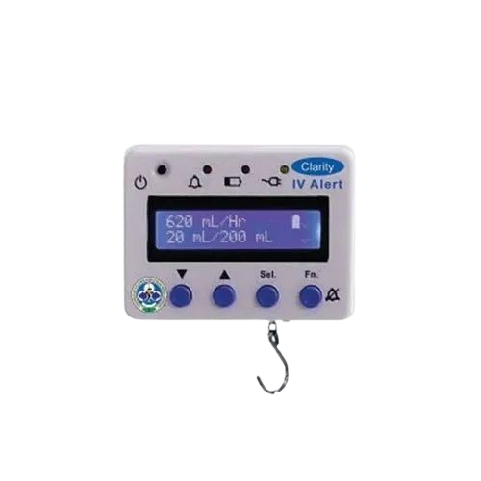
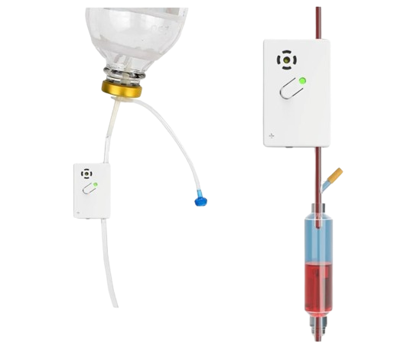
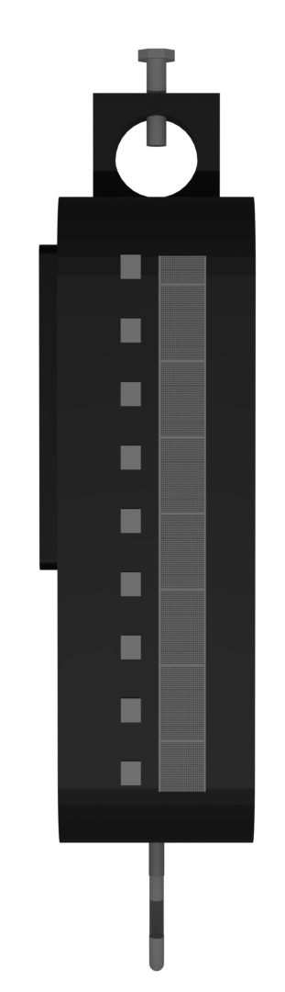
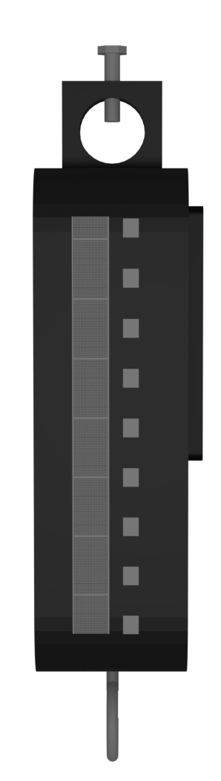
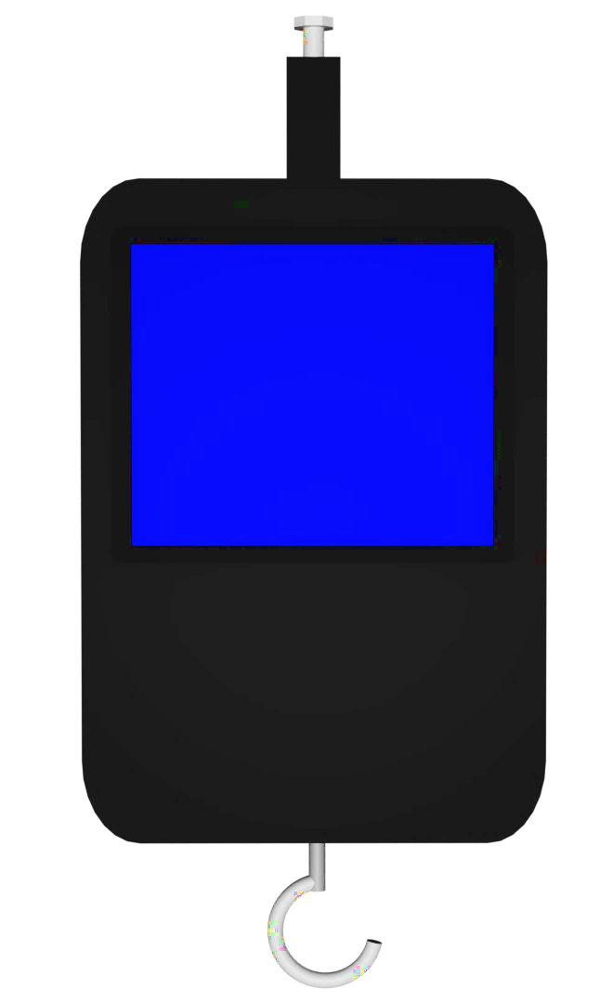
IV GAURDIAN
OBSALINE TECH

Slide 4
Existing Devices
OBSALINE TECH

Slide 5
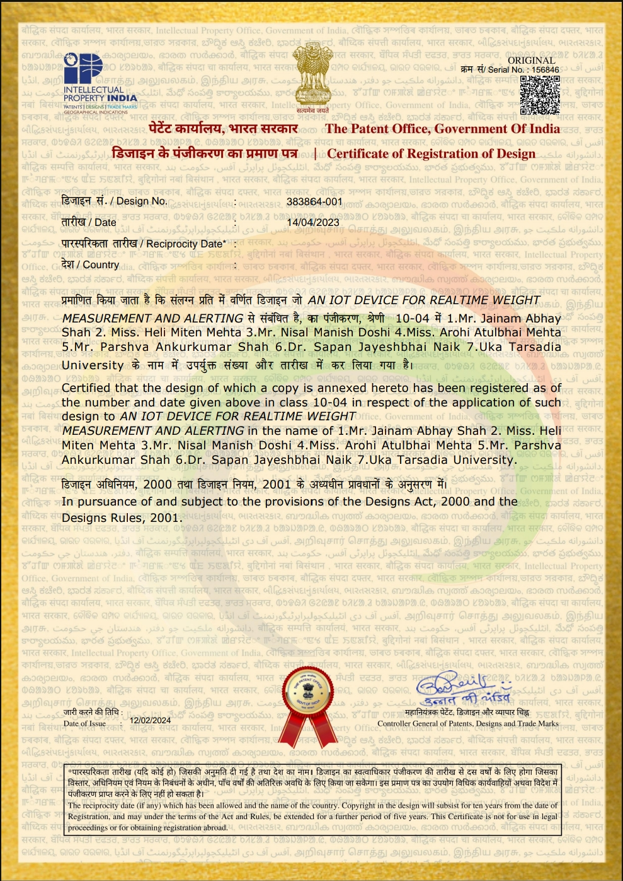
DESIGN PATENT
OBSALINE TECH

Slide 6
COST DISTRIBUTION
PROFIT
800
COMPONENTS
COST
440
INSTALLATION,
ASSEMBLING,
RENT, ELECTRCITY
150
MISCELLANOIUS
EXPENSE &
MAINTAINANCE
110
1500
MAINTAINANCE
OBSALINE TECH

Slide 7
SUBSCRIPTION MODEL
3M - ₹ 54
6M - ₹ 90
12M - ₹ 110
OBSALINE TECH

Slide 8
PHASES
gujarat
INDIA
Phase 1
Phase 2
Phase 3
Phase 4
Metro cities
INTERNATIONAL
OBSALINE TECH

Slide 9
THANK YOU
OBSALINE TECH

